Slide 1
AMT

Slide 2
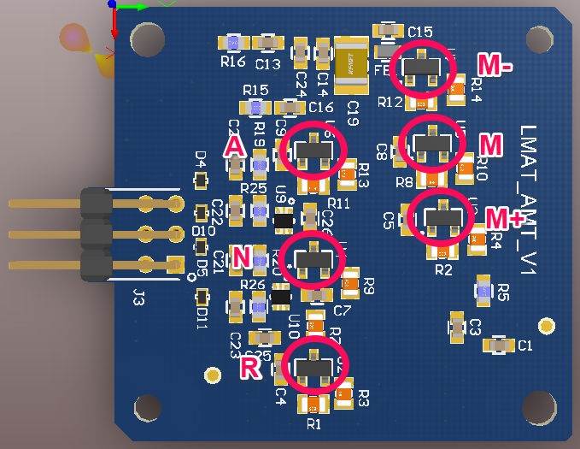
POSITIONS IN PCB

Slide 3
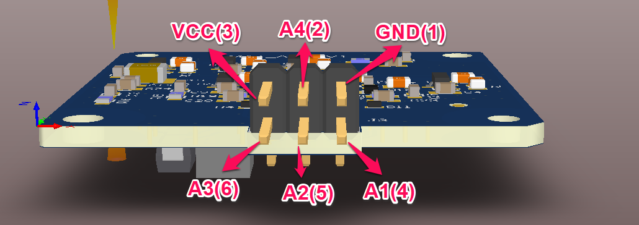
CONNECTOR CONNECTIONS

Slide 4
THANK YOU

